Slide 1


SERENITY FOUNDATION
PREPARED BY-
NAIR SWAPNA SASIDHARAN(62)
AKSHAYAPOOJA A P(14)
PARVATHY S NAIR(76)
GUIDE-
APARNA P V

Slide 2

ABOUT OUR PROJECT
The project seeks to develop a comprehensive software system designed to streamline the management of orphanages and elder care facilities. This system will serve as a centralized platform for handling various aspects of facility operations, including resident records, donation information, medical records, and educational records. By automating and organizing these tasks, the system aims to enhance efficiency, reduce administrative burdens, and ultimately improve the overall quality of care provided to residents.

Slide 3
MODULES OF THE SYSTEM
SIGNUP : User should signup first into the website to be able to login in .
LOGIN: User and Admin would be able to login to the online facility website .
RESIDENT DETAIL: Here all the details of the facility resident will be stored
DONATION DETAIL: Tools for organizing and managing community fundraising efforts and charitable donations.
APPOINTMENT : Tool the user can use to book timing and date to visit the facility and spend time with the Residents.
BILLING: It stores the purchase history of the products sold in the facility store.
RECORD REQUEST: This module will help the admin to send the medical and educational records to the guardians of the resident.

Slide 4
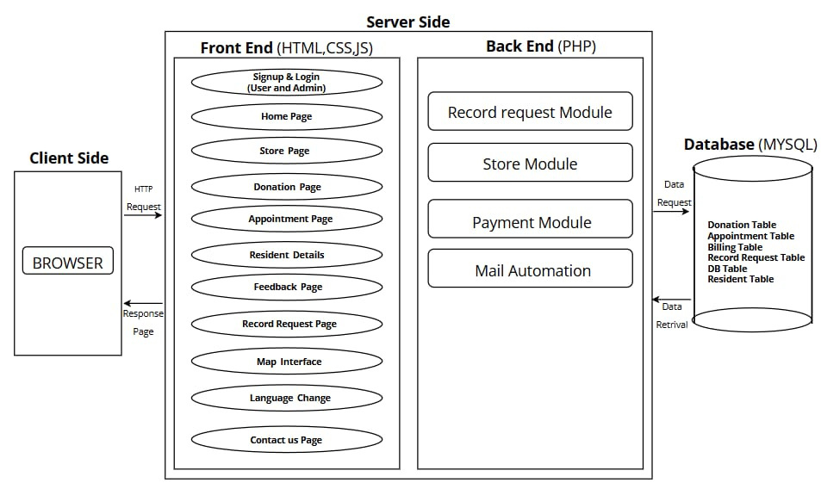
System Architecture Diagram

Slide 5
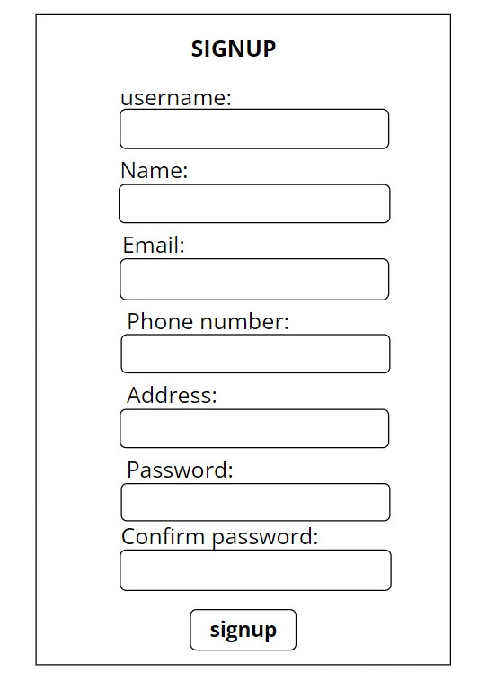
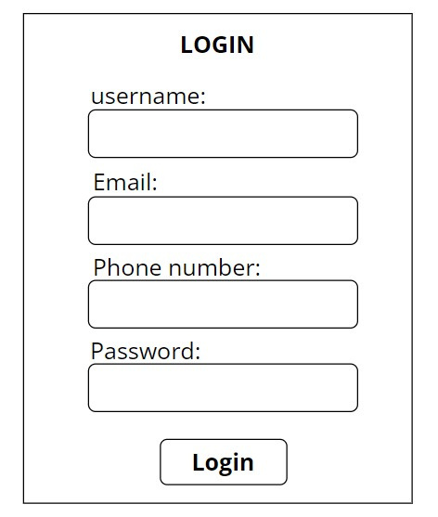
Input/Output Screen design
INPUT DESIGN OF SIGNUP
INPUT DESIGN OF LOGIN

Slide 6
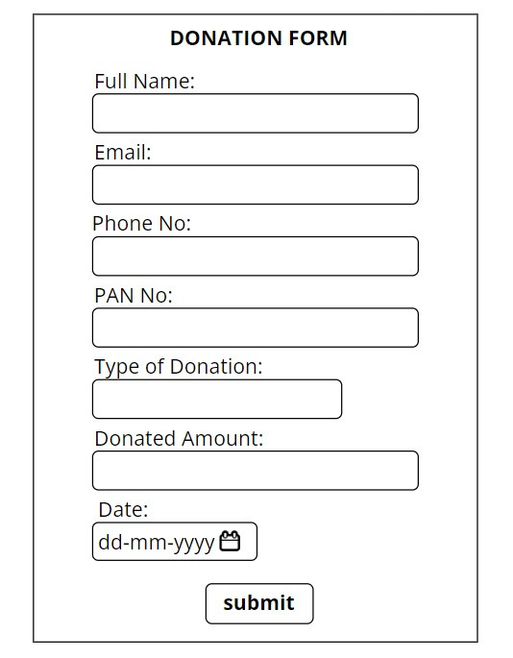
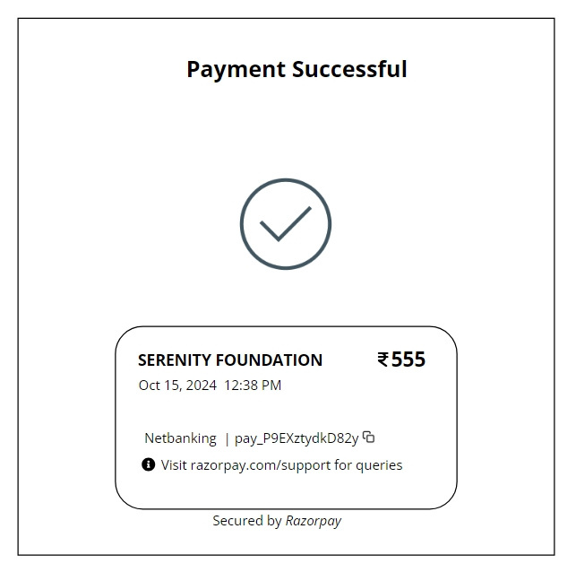
OUTPUT DESIGN OF DONATION
INPUT DESIGN OF DONATION

Slide 7
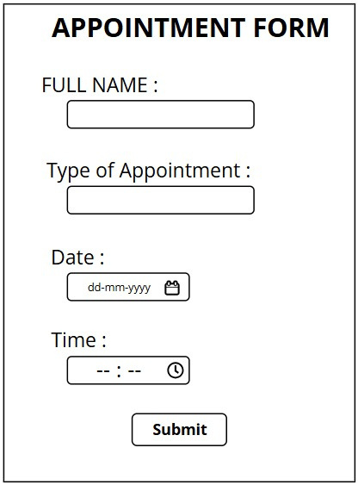
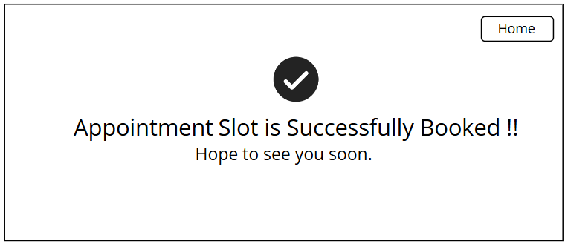
OUTPUT DESIGN OF APPOINTMNET
INPUT DESIGN OF APPOINTMENT

Slide 8
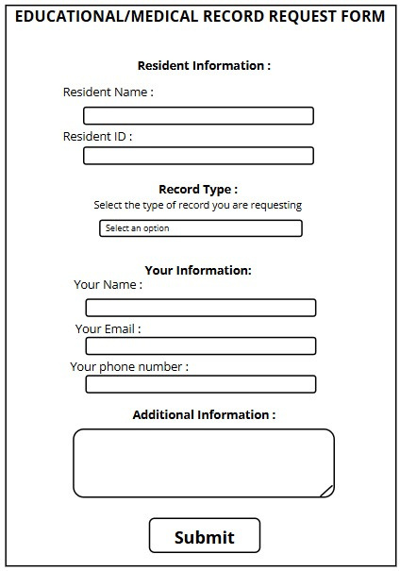
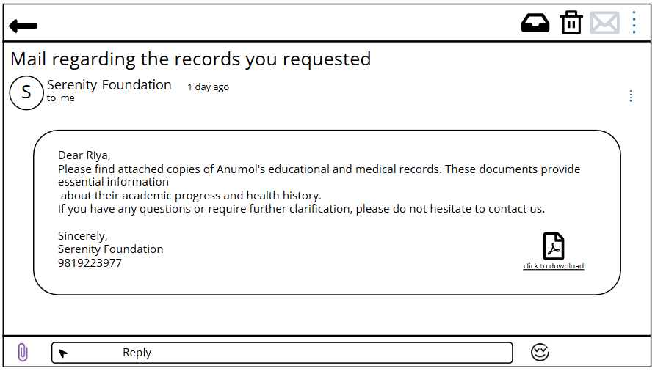
OUTPUT DESIGN OF RECORD REQUEST
INPUT DESIGN OF RECORD REQUEST

Slide 9
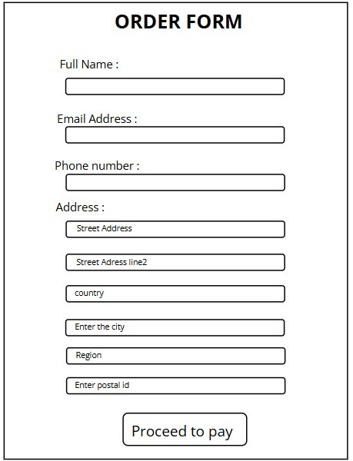
OUTPUT DESIGN OF STORE PURCHASE
INPUT DESIGN OF STORE PURCHASE

Slide 10
THANK YOU !

